Slide 1
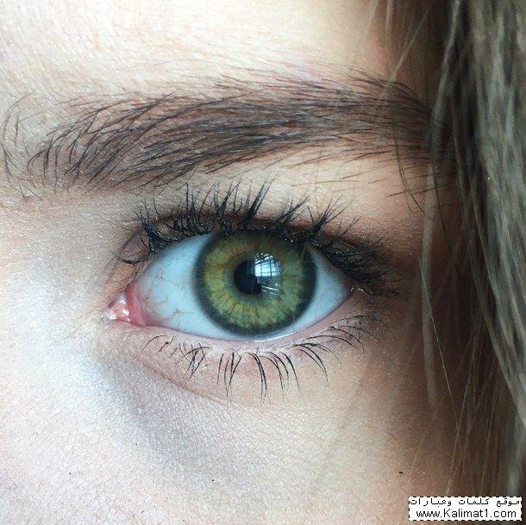

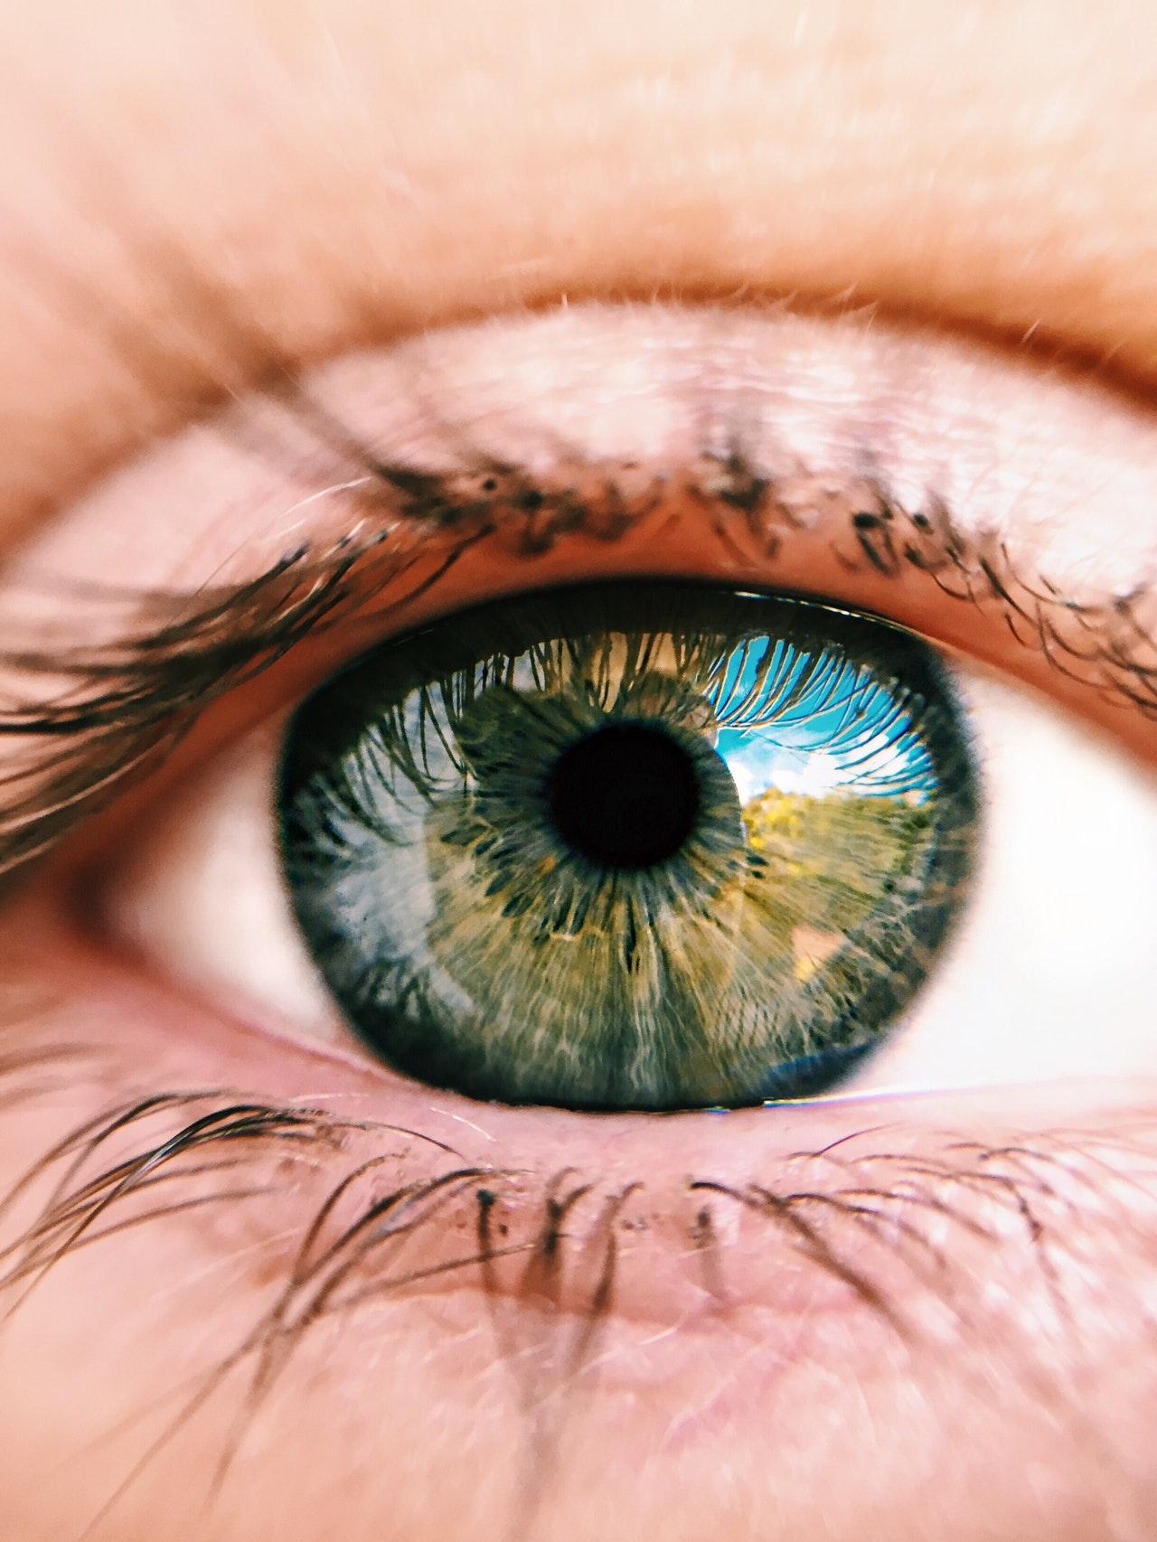


It’s in Your Eyes
Awareness and Control HCI Using EOG Signal
Bioinformatics Department
Faculty of Computer & Information Science
Ain Shams University

Slide 2
Under Supervision
Dr. Manal Mohsen Tantawi TA. Radwa Reda Hossieny

Slide 3
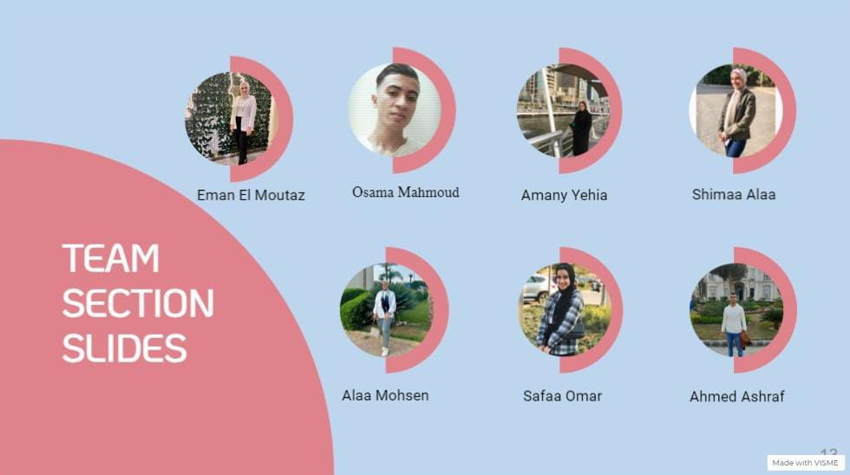

Slide 4
Agenda :
01 Introduction
06 System Flow
02 Problem Definition
07 Results
03 Motivation
08 Demo
04 Objective
09 Conclusion
05 Related Work
10 Future Work

Slide 5
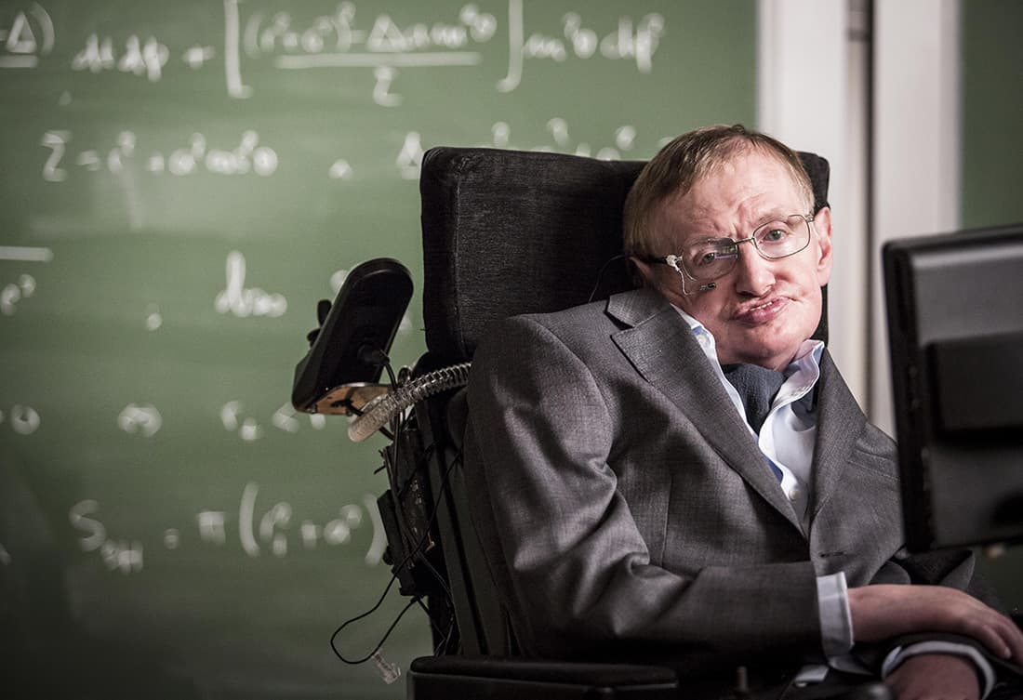
Introduction
Recently, issues related to the disabled have become one of the most important issues. A significant increase in the number of patients with motor disabilities has been observed Worldwide due to the presence of many diseases that cause atrophy of the motor nerves.
This prevents the limbs from moving and extends to the body and causes complete paralysis and only the neurons that control eye movement survive. Patients have no way of communicating with their external environment except through the movement of their eyes, So we decided to help them with EOG signals.

Slide 6
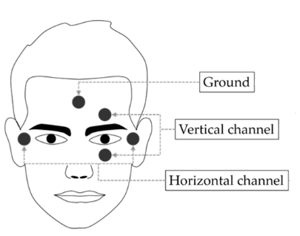
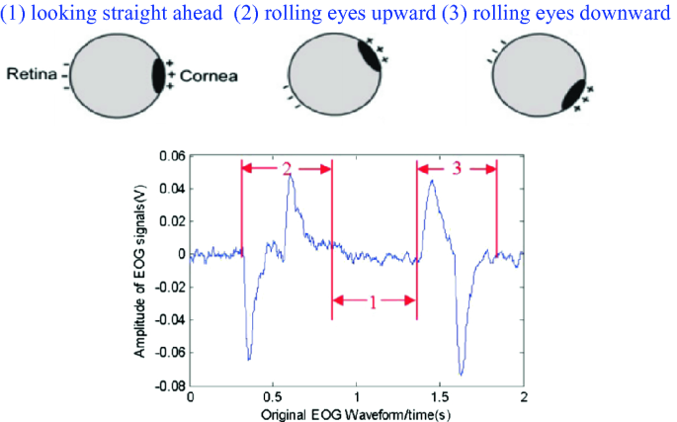
Problem Definition
The Human-Computer Interface (HCI) emerged and became a new means of communication that allows communication between a user and a computer. HCI has turned into an emerging technology due to advances in artificial intelligence and biomedical engineering.
Electro-oculogram (EOG) records eye movement as signals produced from variations in the polarity of the nerve of the eye. EOG recording is performed by a set of electrodes placed horizontally and vertically on the controlling muscles of the eye.

Slide 7
Motivation
According to the continuous increase in the number of these patients in Egypt and the world, A human-computer interface application should be created to help these patients and serve as a communication channel linking them to the external community and allowing interaction with it.

Slide 8
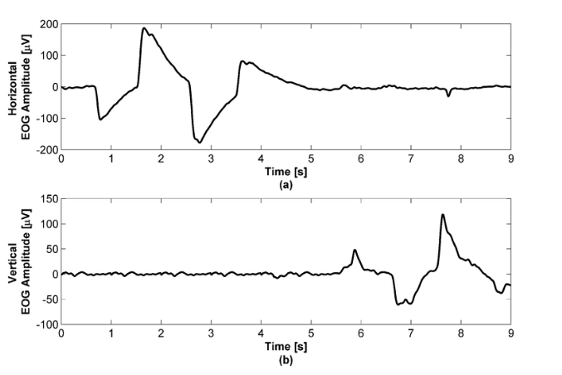
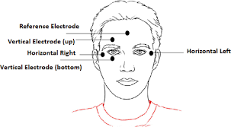
Objective
The objective of this project is to develop a controlling Human-Computer Interface (HCI) system based on electrooculography (EOG).

Slide 9
Related Work
Author | Data Acquisition | Pre-processing | Feature Extraction | Classification | Accuracy
Ahsan-ul Kabir et al. [7] 2020 | 5 subjects | - 2nd order high pass filter cut-off 0.67 Hz. - 2nd order low pass filter with cut-off 33.33HZ,Amplified about 20 times. | - RM - FFT - Gradient | - SVM - MLP | 93% 80%
Tobias Wissel et al. [6] 2011 | 3 Subjects | - Band passer cut-off frequency at 1 Hz and the higher at 5 Hz. - Down-sampling (32 Hz) | -Haar wavelet decomposition | -1NN classifier | 90.50%
Fatma Latifoglu et al. [8] 2020 | 10 subjects | - 4th Butterworth band pass filter with cut-off [0.1 - 15] Hz. | - Read Back Movements Signals. - Jumping Bottom Line Signals. | -Random Tree. -J48. | 90% 92%
Radwa R. et al. [4] 2019 | 20 subjects | Band-pass filter cut-off [0.5 – 20 Hz] Down Sampling | - Mean - Standard Deviation - Energy | KNN LDA MLR NB Decision Tree SVM | 81.5% 80.0% 79.0% 82.0% 76.5% 94.25%

Slide 10
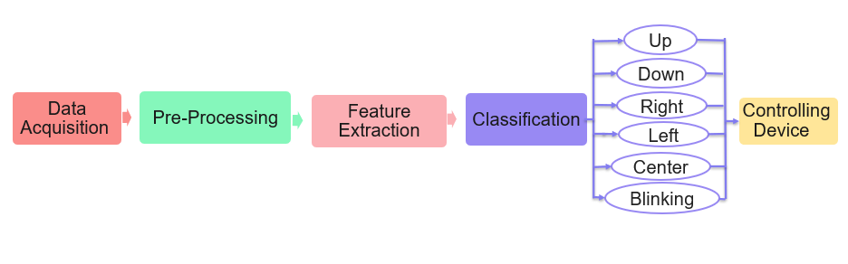
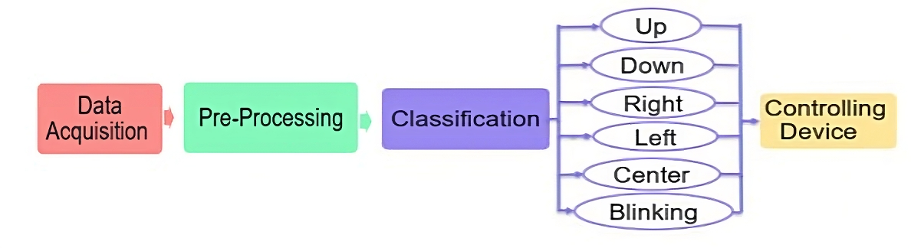
System Flow

Slide 11


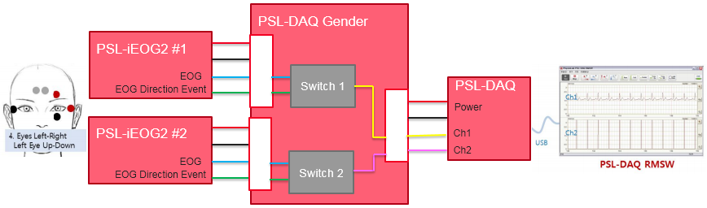
System Flow
Data Acquisition
PSL-IEOG2 Dataset The dataset is constructed by a device called PSL-IEOG2 and the details are as follows:
2. Software(PSL-DAQ RMSW):
The software has two main screens DAQ View and Load View.
DAQ View screen monitors the two channels' signal generated by the PSL-DAQ unit in real-time.
Load View is a screen to review and print the saved signal data.

Slide 12

Dataset
System Flow
PSL-IEOG2 Dataset
The dataset is constructed the 50 healthy subjects with normal vision. The total number is 500 signals (horizontal & vertical). The signal is recorded by giving a set of commands in the following order: up, down, right, left, double blinking, and center. The data for each class is divided into five groups (4 groups for training and the fifth one for testing) resulting in five trials.
PSL-IEOG2 Dataset (Newly constructed)
The data has been increased by registering 15 people so far and it was added to the old dataset after making results from the new dataset. Each person registered 10 times. The total number is 150 signals (horizontal & vertical). The data for each class is divided into 75% train and 25% test resulting in four trials. In order to get better results in accuracy but we used electrodes that are not as efficient as the electrodes that were recorded, and the dataset collected before.

Slide 13

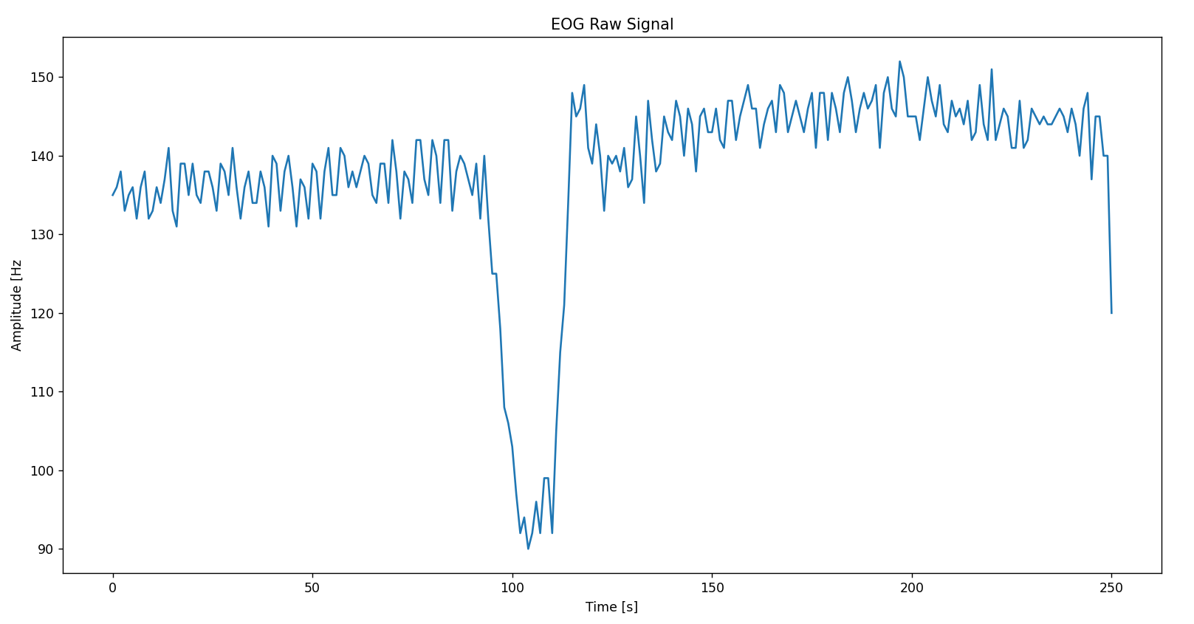
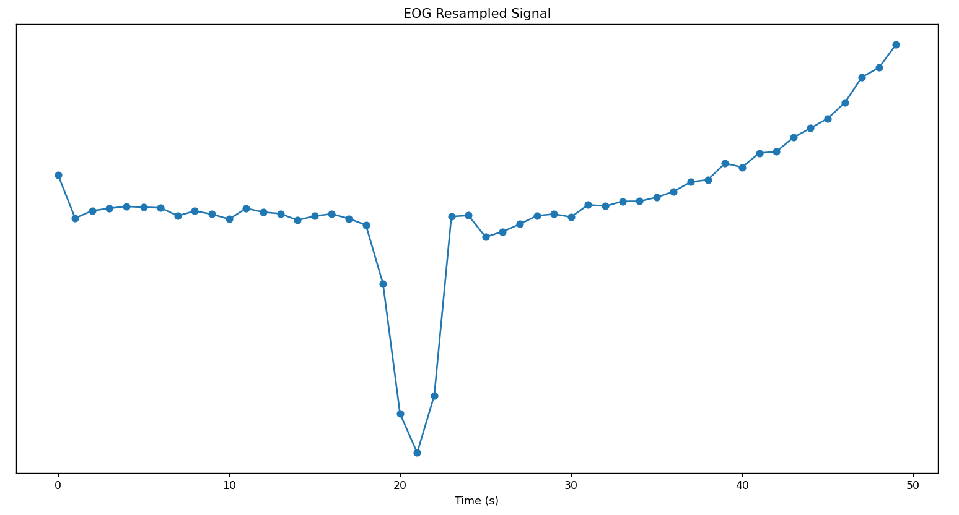
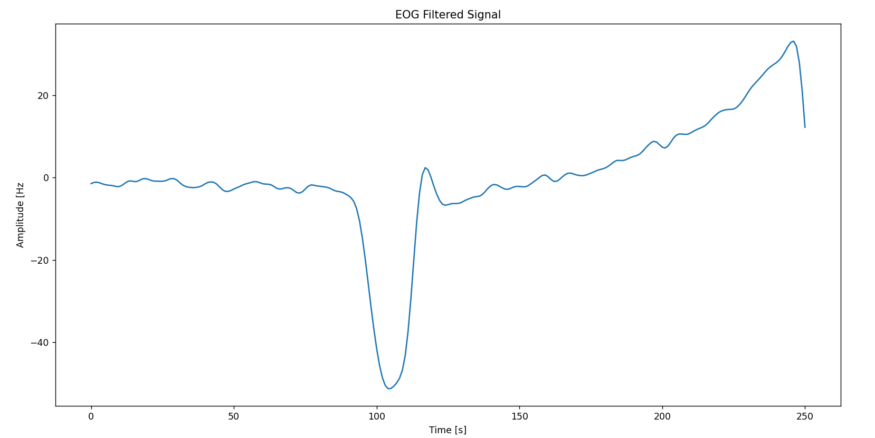
Pre-Processing
System Flow
We started to try more than one technique, and the best of them in terms of results was that:
Butter worth band path filter from 0.5 to 20, second order.
Down-sampling process 1000.To reduce the complexity and assumption of the long-time process.
Before Filtering
After Down Sampling
After Filtering

Slide 14

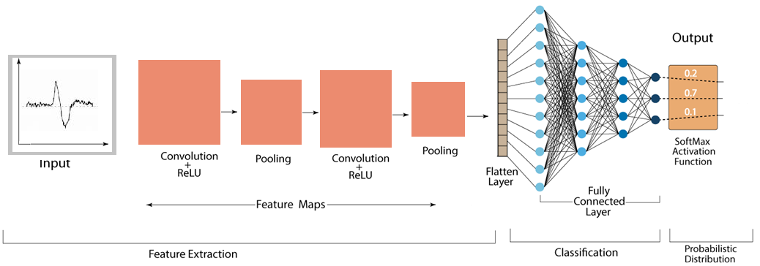
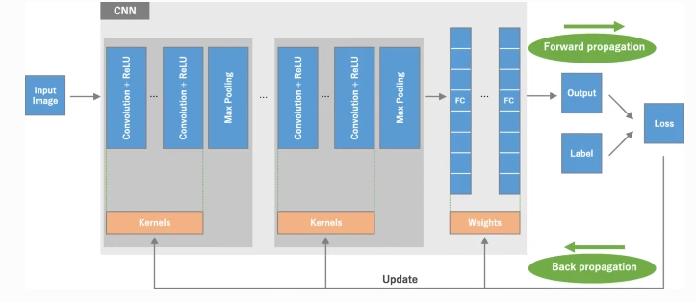
Feature Extraction & Classification (Deep Learning Model): CNN
System Flow
Convolutional Neural Network (CNN) is considered a Multilayer Perceptron network for supervised learning. CNN is distinguished by the detection of the most accurate features from inputs without human intervention, which increases the effectiveness and accuracy of prediction.

Slide 15
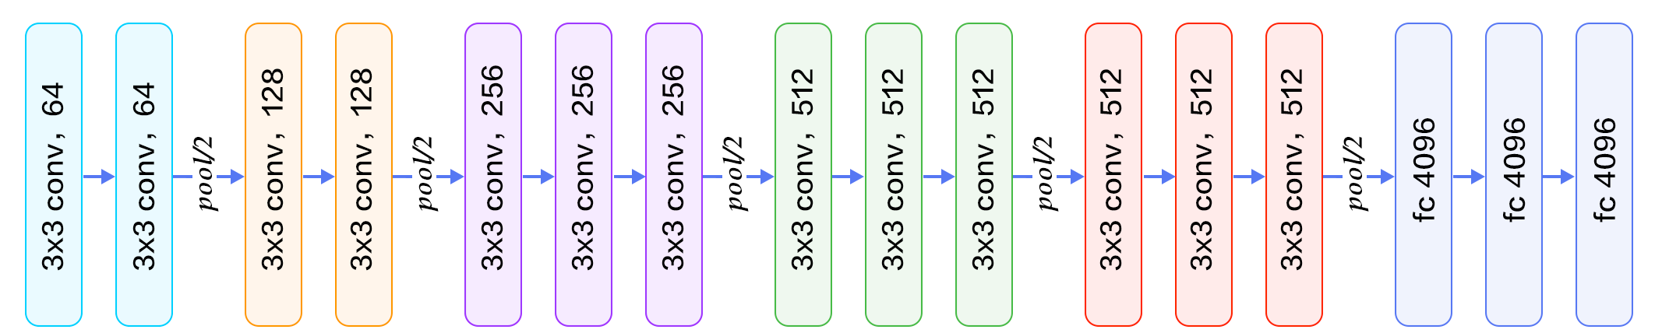
Feature Extraction & Classification (Deep Learning Model): VGG
System Flow
VGG Network is considered an improved convolutional neural network model. It has the advantage of being a light network due to the small size of convolution filters. It supports sixteen layers in its architecture consisting of thirteen convolutional layers and three fully connected layers.
.
Input
Softmax

Slide 16
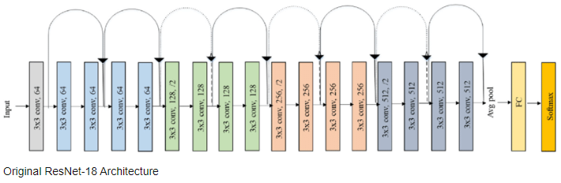
Feature Extraction & Classification (Deep Learning Model): ResNet
System Flow
The residual network structure is more in-depth than other networks. The network is characterized by huge layers. the vanishing gradient can occur and spread between layers with the convolution process. The gradient problem can be reduced by identity block. The main characteristic of its distinction is its formation of five successive stages, the main stages contain a convolution block and an identity block.
.

Slide 17
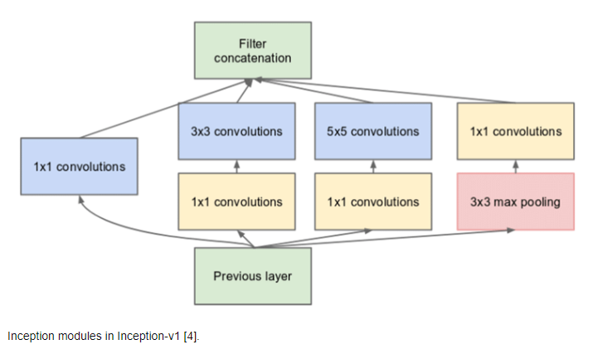
Feature Extraction & Classification (Deep Learning Model): Inception
System Flow
Inception Network: It is considered an advanced structure for deep learning models for solving data detection and classification problems. The inception network is characterized by the extraction of global and local features at the same time.

Slide 18


Slide 19
CNN Results
Experimental Result
.
Influencing Factors | Trial 1 | Trial 2 | Trial 3 | Trial 4 | Trial 5 | Average Accuracy
Change no of epoch to 200, Change Batch Size to 32. Change no of layers to 7. Using Batch Normalization. Use Dropout technique. | 95 | 96.34 | 93.16 | 95.34 | 91 | 94.34

Slide 20
VGG Results
Experimental Result
.
Influencing Factors | Trial 1 | Trial 2 | Trial 3 | Trial 4 | Trial 5 | Average Accuracy
Retrieve ActivationFn to (RELU) Change Batch size =32 , Add padding same to stride =2 Adding Dropouts (0.3) between each block of Conv. | 94.67 | 96.5 | 91.0 | 94.3 | 89.6 | 94.214

Slide 21
Resnet Results
Experimental Result
.
Influencing Factors | Trial 1 | Trial 2 | Trial 3 | Trial 4 | Trial 5 | Average Accuracy
Change Lr to 1e-4 Change batch size to 32 | 94 | 97.57 | 91 | 93.66 | 91 | 93.432

Slide 22
Inception Results
Experimental Result
.
Influencing Factors | Trial 1 | Trial 2 | Trial 3 | Trial 4 | Trial 5 | Average Accuracy
Change batch size to 384 Use Dropout Technique. | 95.33 | 96.5 | 92.16 | 95.3 | 88.33 | 93.53%

Slide 23
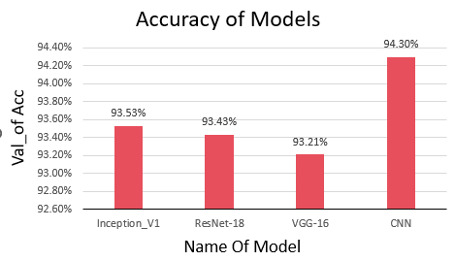
Results Summary

Slide 24
CNN Results
Experimental Result (After inserting new Data)
.
Influencing Factors | Trial 1 | Trial 2 | Trial 3 | Trial 4 | Average Accuracy
Change batch size to 32 Used nu of epoch = 500. Num of layers = 7 Lr = 3e-5 - | 84.88 | 93.22 | 90.00 | 88.77 | 89.22%

Slide 25
VGG Results
Experimental Result (After inserting new Data)
.
Influencing Factors | Trial 1 | Trial 2 | Trial 3 | Trial 4 | Average Accuracy
Change batch size to 64. Used nu of epoch = 200. Kernal size = 32 Lr = 3e-4 - | 63.0 | 92.0 | 86.333 | 90.3 | 82.91%

Slide 26
Resnet-18 Results
Experimental Result (After inserting new Data)
Influencing Factors | Trial 1 | Trial 2 | Trial 3 | Trial 4 | Average Accuracy
we use epoch = 200 batch size = 112 Num layers = 22. ActivationFN is Sigmoid. | 63.7 | 93.67 | 85.77 | 88.56 | 82.95%

Slide 27
Inception Results
Experimental Result (After inserting new Data)
.
Influencing Factors | Trial 1 | Trial 2 | Trial 3 | Trial 4 | Average Accuracy
Change Learning Rate to 1e-4 Change batch size to 32 - | 63.0 | 93.0 | 85.77 | 86.8 | 82.91%

Slide 28
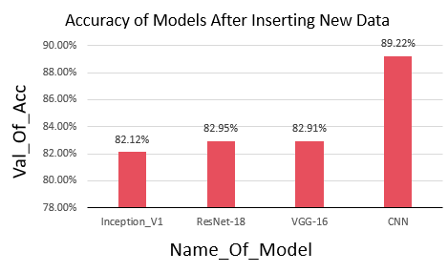
Results Summary

Slide 29

Experimental Result: Demo

Slide 30

Conclusion
The proposed Human-Computer Interface (HCI) system based on electrooculography (EOG) has achieved with the advanced deep learning models.
The experimental result proved that the best average accuracy with CNN model was 94.3%.
the proposed user interface is usable for patients and help the doctor for examinations. The processing time is 5 sec/action.

Slide 31
Future Work
We will test other models of the deep-learning model to increase the current accuracy.
We will work on Real-Time application.
Adding feature Google map screen to detect the nearest Hospital which helps disabled people.

Slide 32
References
[1] Theuer RV, Neves SV, Champs AP. Rehabilitation for motor functional neurological disorder: a
follow-up study of 185 patients. Arquivos de Neuro-Psiquiatria. 2020; 78(Ahead):1-6.
[2] S.Ali, A., El-Samie, F. E. A., & M.Brisha, A. (2021b). Efficient Classification of Horizontal And Vertical EOG Signals For Human Computer Interaction. Efficient Classification of Horizontal and Vertical EOG Signals for Human Computer Interaction. https://doi.org/10.21203/rs.3.rs-471385/v1
[3] PhysioLab. (2019). Biosignal sensor or module by PhysioLab [Online]. Available: http://www.physiolab.co.kr
[4] Reda, R., Tantawi, M., shedeed, H., & Tolba, M. F. (2019). Analyzing Electrooculography (EOG) for Eye Movement Detection. Advances in Intelligent Systems and Computing, 179–189. https://doi.org/10.1007/978-3-030-14118-9_18
[5] Hossieny, R., Tantawi, M., shedeed, H., & Tolba, M. (2022). Developing a Method for Classifying Electro-Oculography (EOG) Signals Using Deep Learning. International Journal of Intelligent Computing and Information Sciences, 0(0), 1–13. https://doi.org/10.21608/ijicis.2022.99424.1126
[6] Kempert H. Clinical overlap of functional neurologic symptom disorder and complex regional pain
syndrome in pediatrics: A case report. Journal of Pediatric Rehabilitation Medicine.2021; 14(4):1-8.
[7] Kabir, A. U., Bin Shahin, F., & Kafiul Islam, M. (2020). Design and Implementation of an EOG-based Mouse Cursor Control for Application in Human-Computer Interaction. Journal of Physics: Conference Series, 1487(1), 012043. https://doi.org/10.1088/1742-6596/1487/1/012043
[8] Latifoglu, F., Ileri, R., Demirci, E., & Altintop, C. G. (2020). Detection of Reading Movement from EOG Signals. 2020 IEEE International Symposium on Medical Measurements and Applications (MeMeA).

Slide 33
Thank You
Thanks for your attention

